Slide 1
Types of Transcriptional Circuits
Notes:
The early work in genetic circuits focused heavily on simple transcriptional circuits. In these systems, a promoter controls a transcription factor that controls a promoter that controls a transcription factor…and so on. Such systems can have very interesting dynamics and provide a challenging test case for precisely controlling the dynamic behavior of cells. They are also proposed as control circuitry for regulating biosynthetic devices, developmental processes, and biological computing.

Slide 2
Constitutive expression
gfp
Inverter
Cascade
Autoregulation
Toggle Switch
Repressilator
Notes:
In all cases, transcriptional circuits can be described as a directed graph composed of transcriptional units that are nodes and the edges designate their connectivity. What differs from one transcriptional circuit to the next is how many nodes are present, and what is their repressor connectivity. Several of the simple configurations have been given names in the field, so let’s outline them briefly. In each case, there is an input promoter, and at the start of the experiment, that promoter is turned on by deprepression of a transcription factor. So, typically, this input promoter will be the tet or lac promoter. I designate that promoter here as a grayed out arrow symbol. Similarly, in each case there will be an output reporter, which I’ll describe by a greyed out GFP gene. So, the simplest genetic circuit is the one we’ve been discussing: a simple inducible promoter driving GFP.

Slide 3
The Inverter
R
r
gfp
Notes:
In the Inverter, we add a single transcriptional repressor. The input promoter drives the r gene resulting in R protein, which represses some P_r promoter controlling the output GFP. Let’s consider what this circuit would do under the limiting cases. If the input promoter is low, the R will not be made, and GFP will be high. If the promoter is high, then R is high and GFP is low. Thus, the output GFP signal is the inverse of the input promoter’s transcription rate.

Slide 4
The Cascade
R
S
r
s
gfp
Notes:
In a cascade, we place the repressors in a daisy-chain configuration where each added repressor represses the next until finally the last promoter controls GFP. When we use two such repressors, high input promoter transcription results in high R, which results in low S, and then high GFP. When input promoter concentrations are low, low GFP results. Thus, putting two inverters in a row like this has the effect of inverting the inversion. When you combine an even number of repressors in a row, you get a monotonically increasing response to input. When the number of inverters is odd, you get inversion.

Slide 5
Negative Autoregulation
R
r
gfp
Notes:
The remaining circuits involve negative feedback. In negative autoregulation, we place the repressor downstream of the promoter it represses. We’ll describe this one in detail later.

Slide 6
The Toggle Switch
R
S
r
s
gfp
Notes:
When we have two repressors that inhibit each other’s transcription, one will dominate over the other resulting in bistability: the system of molecules has two steady states, one in which R dominates and S is repressed, and the other in which S dominates.

Slide 7
The Repressilator
R
S
r
s
gfp
T
t
Notes:
If we expand that to three repressors in a cycle of repression, we can get oscillatory behavior whereing R, S, and T repressors take turns being the most concentrated transcription factor.

Slide 8
Toggle Switch and Repressilator
PMID: 10659857
PMID: 10659856
Notes:
The Toggle Switch by Collins and the Repressilator by Elowitz were two of the early demonstrations of a genetic circuit design.

Slide 9
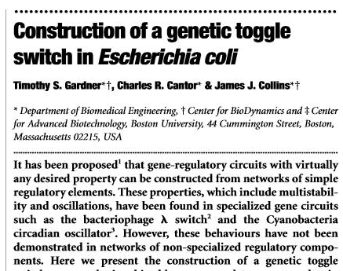
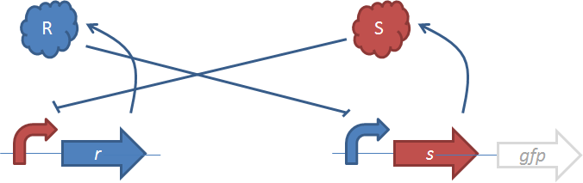
The Toggle Switch
Notes:
The toggle switch is based on two mutally repressing transcription factors.

Slide 10
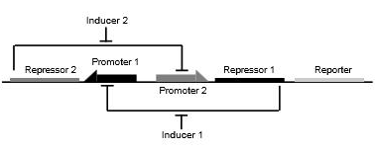
The Toggle Switch
Notes:
They draw the comparable diagram as such where our R and S are designated repressor 2 and repressor 1. Other than labeling, these are equivalent diagrams. Note that when we speak of toggle switches and devices in general, there is often a lack of clarity about whether we are speaking of a specific dna sequence, a specific composition of seqeunces in which their order and specific sequences is unspecified, or an even more abstract representation of the interaction connectivity. When we speak of the toggle switch and repressilator, we are speaking of this more abstract definition of the device, and many specific sequences could conretize these specific gene and promoter specifications. They construct their genetic circuit from the Tet repressor and Lac repressor

Slide 11
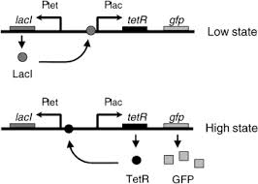
The Toggle Switch
Notes:
So, we can express what they built a little more concretely now. The toggle switch turns out to exist in two bistable states. If you kick-start the system with IPTG, Plac is ON,, so tetR is high, Ptet is repressed, and the cells aare green. If you kick-start the system with atc, then Ptet is on, so lacI is high, and tetR and gfp production becomes low. By bistable, we mean that the system will return to the high or low state once it has entered that state and persist in that state. Thus, when you induce the cells one way or the other, then remove the inducer, the cells will stay in whichever state you put them in.

Slide 12

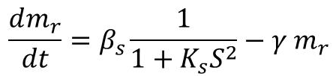
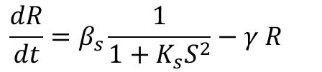
Modeling of Toggle Switch
Notes:
Let’s do some math. The species we want to describe are the R and S concentrations, and we want to model their change over time in terms of differential equations. The concentration of R protein goes up when an R mRNA (m-sub-R) is translated, and R goes down when one decays or the cells become grow and become more dilute. This is the typical way we have been modeling translation when there is no translation control taking place.
*
Thus, all the relevant aspects of the model are contained by the equations expressing the mRNA’s concentration over time. The change in r’s mRNA over time can be described using Shea-Ackers. If S binds to the promoter as a dimer, then the exponent in our fraction term is 2, so the fraction of promoters active for transcription is given by 1 over (1 + S^2), and we multiply that with whatever the maximally-expressed rate is for the PS promoter, so that’s beta-sub-S. Those mRNAs also dilute out over time at some rate gamma, so we have a –gamma times Mr term. It is customary to make an approximation that assumes that protein product is simply proportional to the mRNA concentration, and this is indeed true with a steady state assumption. Thus, we can model R without mention of the mRNA as some rate constant betaS over 1 + KsS^2 minus gammaR.

Slide 13
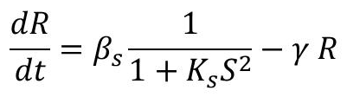
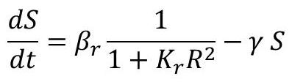
Modeling of Toggle Switch
Notes:
Since the two inverters are arranged symmetrically, the equation for S looks about the same, just switching the letters R and S.

Slide 14
Modeling of Toggle Switch
Notes:
The de-dimensionalized versions of these equations is described in the paper. They call them u and v in the paper, but we’ll call them x and y.

Slide 15
De-dimensionalized Model
x – concentration of repressor 1
y – concentration of repressor 2
α_{1,2} – effective rate of synthesis of x,y
β,γ – cooperativity of repression from
promoter 1,2
Adapted from math.la.asu.edu/~kuang/class/toggle.ppt‎
Notes:
Just to re-orient you let’s go back through these variables. X and Y are the concentrations of repressor 1 and 2. The alpha terms are the synthesis rate of x and y. Beta and Gamma are the cooperativity of repression from promoter 1 and 2, which usually will have the value of 2 since usually these repressors function as dimers.

Slide 16
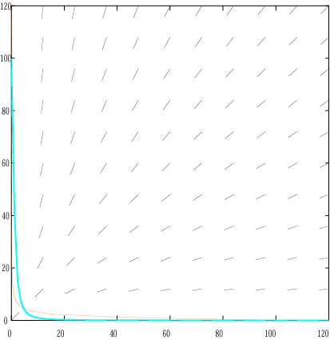
Steady States
Nullclines
Parameters
α₁=α₂=100
β=γ=2 (β, γ>1)
three steady states; one unstable, two stable – bistability
in the case of β, γ=1
there is one stable steady state
stable
steady state
(High)
y
stable
steady state
(Low)
unstable
steady state
x
Adapted from math.la.asu.edu/~kuang/class/toggle.ppt‎
Notes:
There are multiple things you can do once you have a differential equation model of your system. You can simulate it numerically and explore the effect of parameters and variables. You can also ask questions about the model analytically. In this case, the authors are discussing the steady states of the system.
*
When the values of beta and gamma are 2 (or in other words when they are dimers) this system has three steady states, one is unstable and two are stable. The unstable one corresponds to the condition when the rates of R and S transcription balance each other out and neither dominates. The stable states correspond to the conditions in which mostly R or mostly S is being produced.
*
When the binding of the transcription factors is not cooperative and operate as monomers, the beta and gamma have the value 1 and have only one stable steady state.

Slide 17
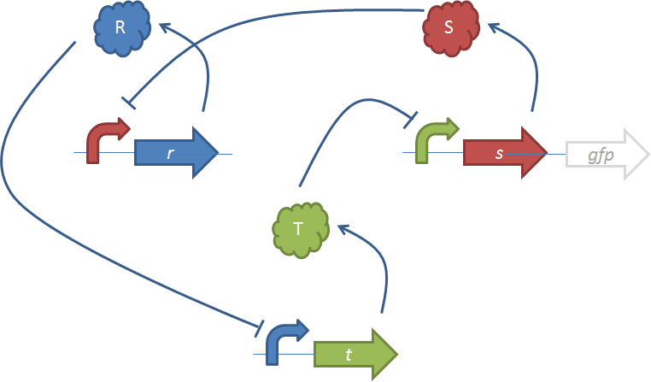
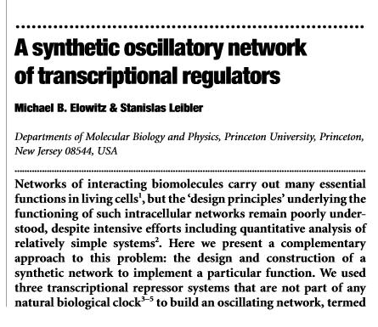
The Repressilator
Notes:
In contrast to the toggle switch, the repressilator is based on three mutually-repressing transcription factors.

Slide 18
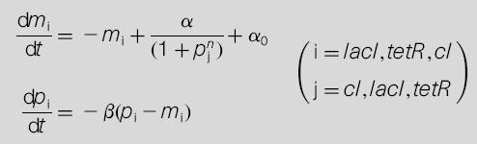


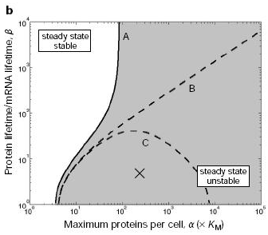
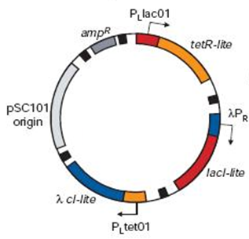
The Repressilator
Notes:
Two of these three inverters are the same as those in the toggle switch: tetR and lacI controlling Ptet and Plac. The third inverter uses the lambda repressor.
*
Elowitz models the system in terms of 6 differential equations expressing the m and p terms for each transcription factor. Notice that these equations have the same form as those in our previous derivation. The protein terms are first order with respect to the mRNA concentration and the protein concentration. The equations look a little different because they have been de-dimensionalized differently. However, this is the same basic model.
*
When they scan through the parameter space they find that different values of alpha and beta terms give rise to different behavior. There are some regimes in which one transcription factor dominates leading to stable states. For a specific window of parameters, the system is unstable and will oscillate.
*
Experimentally, they build the repressilator on a single plasmid

Slide 19
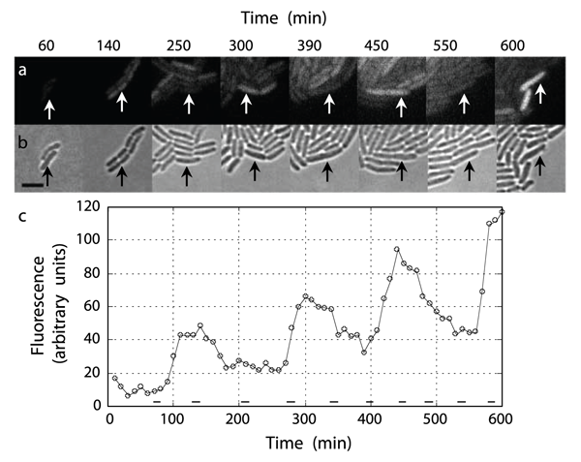
The Repressilator
Notes:
And for certain expression levels of the three components the system will oscillate. Here they synchronize the cells at time zero by addition of atc, and then they follow the cells’ fluorescence over time as they grow on an agar pad. They observe pulses of increased GFP production from the tet promoter every 150 minutes or so.

Slide 20
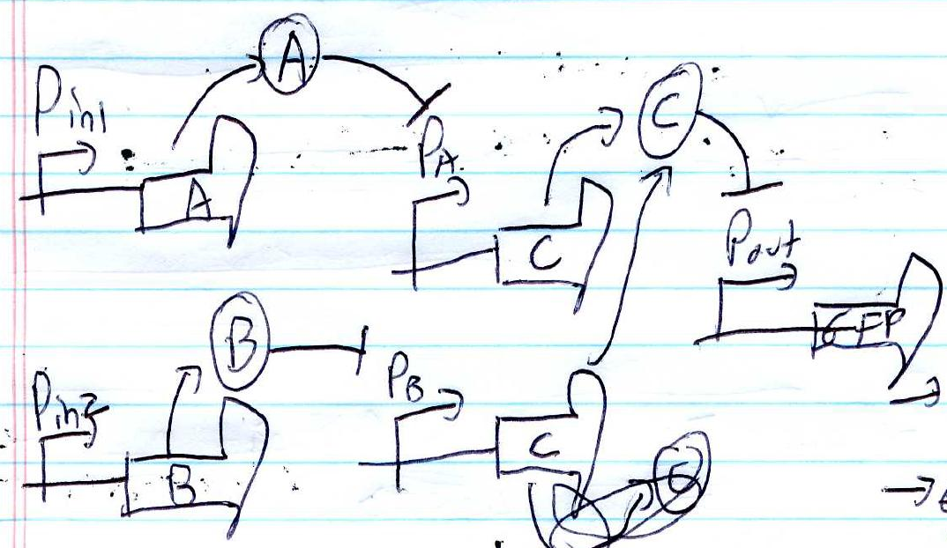
Write differential equations for this circuit:

Slide 21
Write differential equations for this circuit:

Slide 22
Transcriptional Cascades
PMID: 15738412
Notes:
Cascades of similar signaling events are a common theme in biology. We see kinase cascades throughout eukaryotic regulation, and it also common to see transcription factors controlled by other transcription factors. When I was in school, it was not understood why these cascades occurred. It was falsely explained as some amplification-of-signal behavior. It turns out that these cascades do something more subtle to a signal.

Slide 23
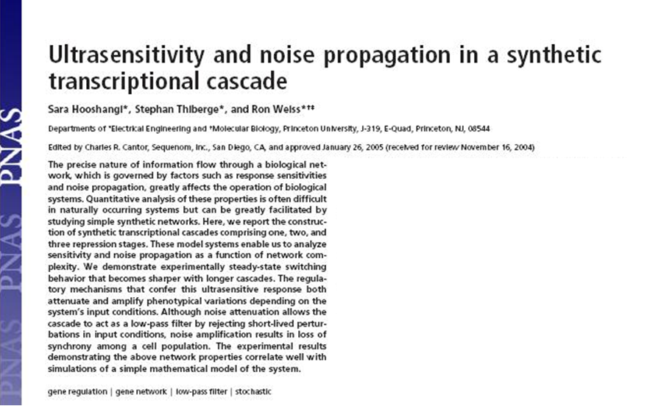
Supplementary information:
http://www.ncbi.nlm.nih.gov/pmc/articles/PMC552778/bin/pnas_102_10_3581__.html#F1
Notes:
In this study by Weiss and coworkers, they explore computationally and experimentally what happens when you daisy chain several transcriptional repression circuits in a row.

Slide 24
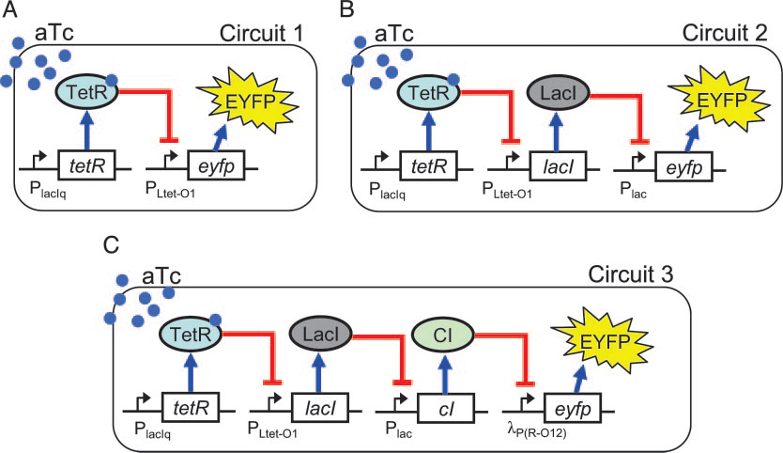
Cascades of inverters
Analyzing the effect of a cascade of inverters on the transfer function for a genetic circuit
Notes:
Let’s start with the wetlab experiment. They describe the same repressor proteins (tetR, lacI, and cI) as was described for the toggle switch and repressilator, but instead of being arranged cyclically, these are the open designs. In each circuit, the cells are ‘turned on’ by addition of aTc which will de-repress the tet promoter at time zero. Circuit 1 is the simple case of ‘consitutive expression’ we described in an earlier video. In circuit 2 we have an intermediary inverter, and in circuit 3 we have two such inverters.

Slide 25
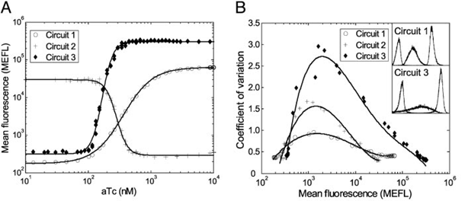
Role of secondary structure
Odd numbers invert, even numbers are monotonically increasing
The transfer function for each circuit wrt inducer concentration becomes sharper with more stages
Population heterogeneity at intermediaary concentrations also increases due to noise amplification
Response time heterogeneity also increases with more stages
Notes:
In figure A, they describe the fluorescense of the cells as a function of aTc, so in effect they are tuning the knob of input promoter strength and montoring the output of each of the three designs. You’ll notice that with no intermediary inverter, the system is monotonically increasing. With the single lacI inverter added, the signal is inverted, and with the second inverter the system is monotonically increasing again.
*
They also note that the slope of the response is greater with more stages. Mathematically, this can be shown to require cooperative of repressor binding. If the repressors are monomers, this ultrasensitivity effect is not observed.
*
In figure B, they plot the variability from cell to cell as a function of fluorescense. They find that with increased numbers of stages, the variability increases. This is postulated to be the result of noise amplification.
*
They also observe that the response time becomes more heterogeneous as the number of stages increases.
All these behaviors can similarly be captured in the differential equation and stochastic models and correlate well with experiment.

Slide 26
Are bistability and noise intrinsically related to one another?

Slide 27
Negative Autoregulation
PMID: 12417193
Notes:
Negative Autoregulations results when a transcriptional repressor is placed downstream of a promoter that is under its own control.

Slide 28
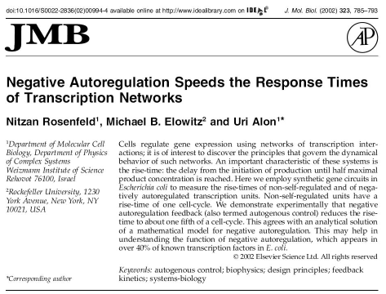
Notes:
In this paper by Alon and coworkers, they demonstrate that regulation with this pattern can speed up the response time of a gene. They define ‘rise-time’ as the delay from the initiation of production until half-maximal product concentration is reached. Using a combination of modeling and experiment, they demonstrate that this pattern can accelerate the rise-time 5-fold.

Slide 29
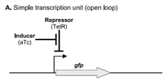
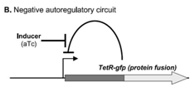
Negative autoregulation comparison
In first, tetR is provided in trans; in second tetR is under Ptet
Negative feedback is a very common motif for TF-coding genes
Comparing the rise time with and without negative feedback
Model the two circuits and compute rise time
Build the two circuits and follow single cells
Notes:
They describe two different gene configurations. In the first case, GFP is placed under a simple transcriptional unit composed of the tet promoter. Tet promoter is repressed by the tet repressor (tetR). Addition of the small molecule anhydrotetracycline, or aTc will de-repress TetR resulting in transcription. In the other case, the negative autoregulatory circuit, the promoter is still a tet promoter, but tetR is being expressed from a second constitutive tetR gene. GFP is also fused to TetR. Thus, expression of the tet promoter results in production of a the tetR-GFP fusion protein which then shuts down its own expression.
*
Negative feedback is a very common motif observed in genes encoding transcription factors. This is particularly true for sigma factors and histidine kinases.
*
One potential explanation for this is that negative feedback affects the response time of the gene. In this study, the authors are comparing the rise time with and without negative feedback.
*
To do this, they do some differential equation modeling and analysis to show that rise-time is different between the two circuits
*
And they also build the two circuits shown here and follow their dynamics by monitoring single cells with fluorescense microscopy.

Slide 30
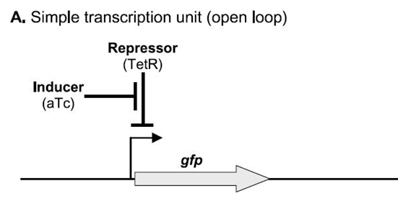

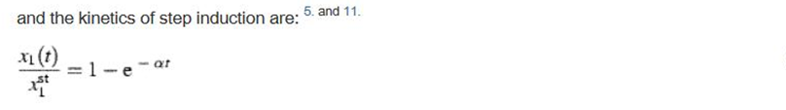
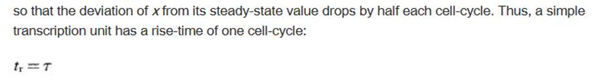
The comparison
Notes:
Let’s go through the math. First, let’s consider the rise-time of the simple transcription unit. Since there is no feedback in this circuit, A is constant and has the value beta, which is the transcription initiation rate of the non-repressed promoter. The rate of change of protein x, or dx/dt is equal to the production rate A minus a first-order dilution or degradation term –alpha*x. As time approaches infinity, the system will reach a steady state in which synthesis and dilution balance each other out. To solve for the value of x in this state, we set dx/dt equal to zero,
*
and solve for x which turns out to be beta over alpha. If we solve the differential equation for x as a function of t, and then divide through by this beta-over-alpha value for the steady state, we get that this ratio is 1 – e^-alpha*t. When this has a value of one half we are at half maximum.
*
If we assume that dilution caused by cell growth dominates the alpha term, then this means that the deviation of x from its steady state value will drop by half each cell cycle. Thus, the rise time of the circuit is one cell-cycle. The cell cycle time is described by the variable tau. Thus tr, the response time, is equal to tau.

Slide 31
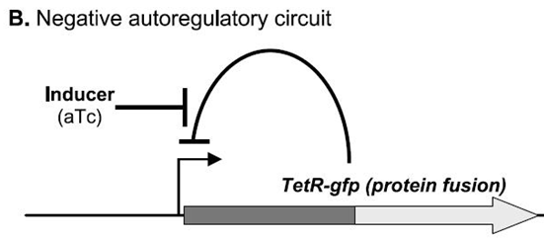

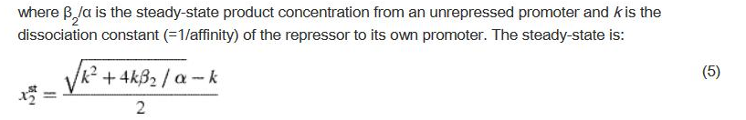


The comparison
Notes:
To model the negative feedback circuit, we start with the same equation, but now we will not assume that A is constant but rather that it has a rate that depends on the concentration of the transcription factor, x. This is the scenario we encountered before when we did Shea-Ackers modeling of repression where we said that the fraction of promoters available for transcription is given by 1/(1+R).
*
Here R is x, so we get an expression A(t) = beta/(1+x/k) where k is the binding constant for the transcription factor to the promoter.
*
Again we make a steady state assumption and solve for x and get this expression. If the repressor has very strong affinity for its binding site, then beta-over-alpha will be much greater than k, and the math
*
simplifies to the square root of k-beta over alpha.
*
Solving the differential equation and dividing by the steady state we get an expression for the deviation from steady state.
*
That will reach a value of 50% when t equals 0.21 times Tau. Thus, the negative autoregulatory circuit reaches its new steady state in 1/5th the time of the open circuit.

Slide 32

The comparison
From first circuit:
From second circuit:
The parameters of the two designs can be set to achieve an equal steady-state by assigning a relatively weak promoter to the unrepressed circuit and a strong promoter to the autorepressed circuit
Substituting in a faster degradation rate of the proteins doesn’t change the result, just replaces tau with a different timescale
Considering the mRNAs in the model doesn’t change result either
Notes:
They go on to analyze and discuss other aspects of the math and its dependence on variables you might think to tune in the system. In addition to the response time, there is also a different steady state concentration. The first circuit reaches a steady state concentration of beta-over-alpha while the second circuit reaches the square root of k-beta over alpha. ) If we use the same promoter and strain for both circuits, the values of beta and alpha will be the same to a first approximation, and the second circuit will plateau at a lower x concentration than the open one. Experimentally, the two circuits could be re-balanced by changing the -35 and -10 sequence of the open circuit. By putting in a weaker promoter, a lower value of beta is achieved, and the two circuits will reach similar steady state concentrations. Doing so would not change the relative response time as that only depends on alpha in both cases.
*
If, for example, you added a degradation tag to the protein, you could achieve faster degradation than dilution, but this would not change the result – the value of tau just gets replaced with a faster value.
*
As long as we aren’t adding any translational control mechanisms into the mix, it doesn’t matter if we change the ribosome binding site or sequence of the protein – the effect should be the same, the autoregulated circuit is always 5x faster than the open one.

Slide 33
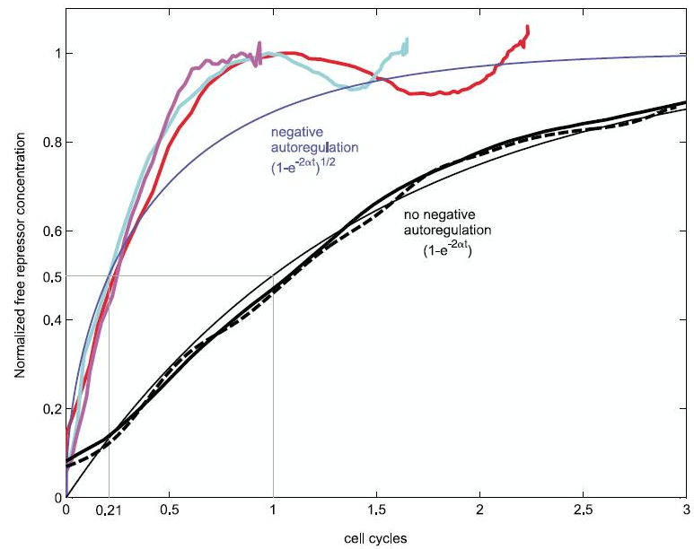
Building the circuits
Notes:
Finally, they build the two circuits and follow fluorescence over time, and indeed, without the negative feedback (in black lines) the system has a much slower response time than the autoregulated ones in colored lines.

Slide 34
Why does it make sense for regulatory genes to feature negative autoregulation?

